Slide 1
Types of Muscle
There are 3 types of muscle in our bodies
Skeletal
Smooth
Cardiac
Each has different characteristics that we will look at today.

Slide 2
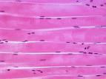
Skeletal Muscle
Voluntary – we control the movement
Striated – looks like long fibers
Linked to bones by tendons
Function – to help us move / move our bones

Slide 3
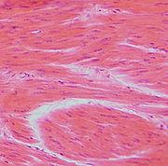
Smooth Muscle
Involuntary Action –
controlled by our CNS
Non-striated
Found in arteries, veins, intestines, etc.
Function : Maintain organ dimensions – stretch and recoil

Slide 4
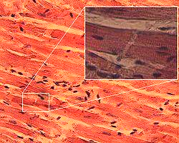
Cardiac Muscle
Involuntary
Striated – but, may
be branched which is unlike skeletal muscle.
Found in walls of the heart
Function : To pump the heart!!!!
Highly resistant to fatigue w/ lots of mitochondria

